Slide 1
Math/Coding/AI Week

Slide 2
Overall Agenda
Day | Topic to Cover
Day 1 | Intro to Math Programming
Day 2 | Simple Models
Day 3 | Intro to Machine Learning
Day 4 | Intro to Neural Networks (AI)

Slide 3
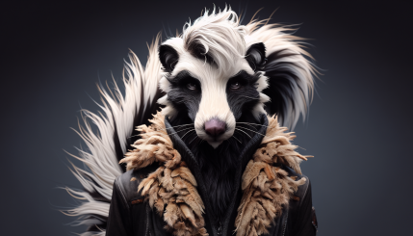

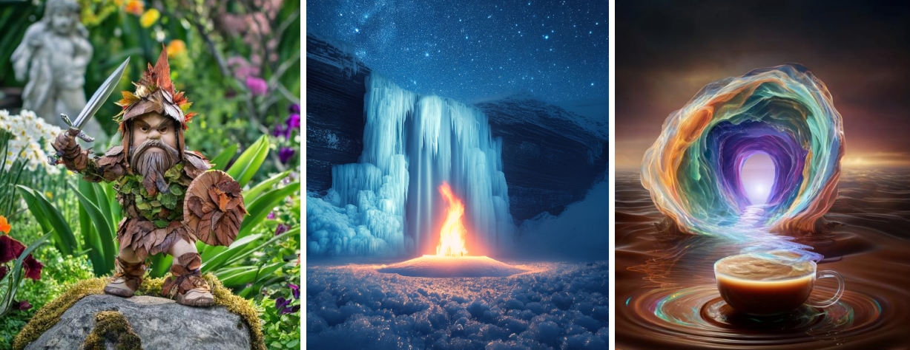
Why does math matter? This is AI generated artwork. It’s a bunch of math.
Notes:
This first slide is just fun and to inspire you about what we can do with math. The main calculation in every neural network is y=mx+b, the stuff that you recently learned. It’s basically that plus a bunch of other math tricks on top of that.

Slide 4
Day 1: Intro to Math Programming

Slide 5
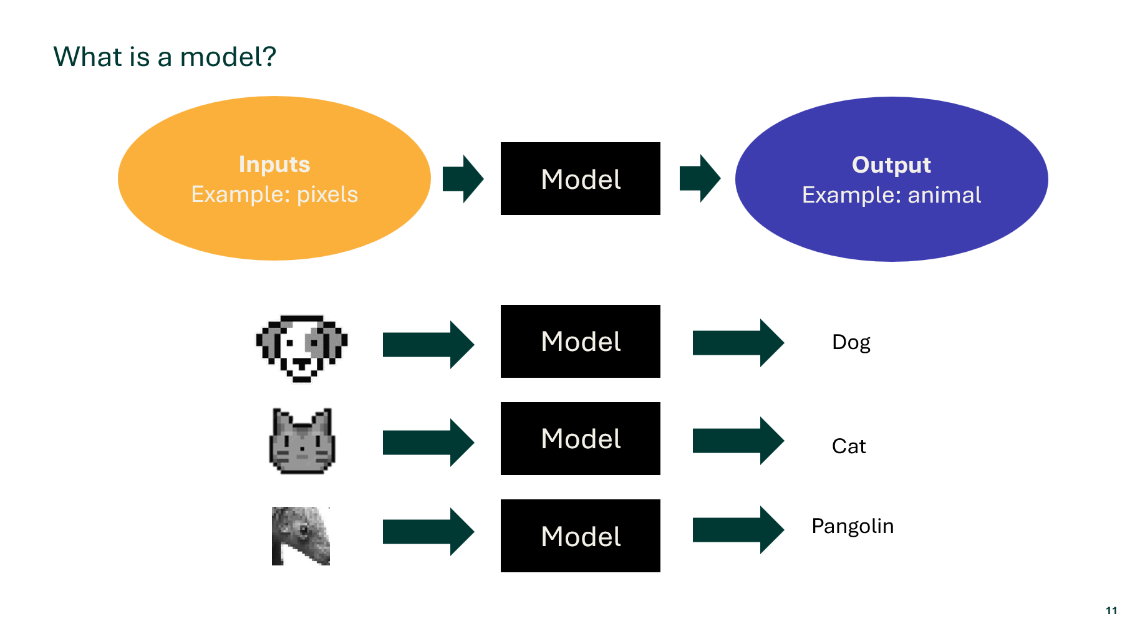

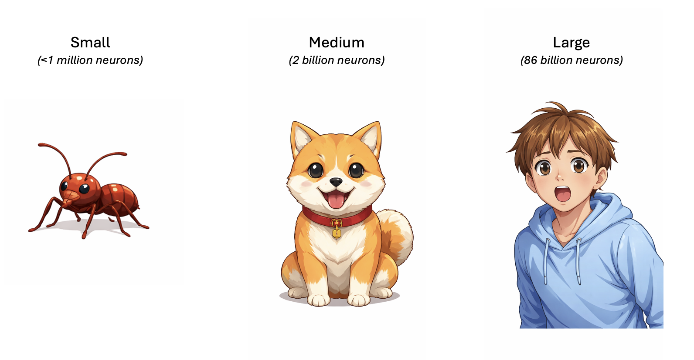
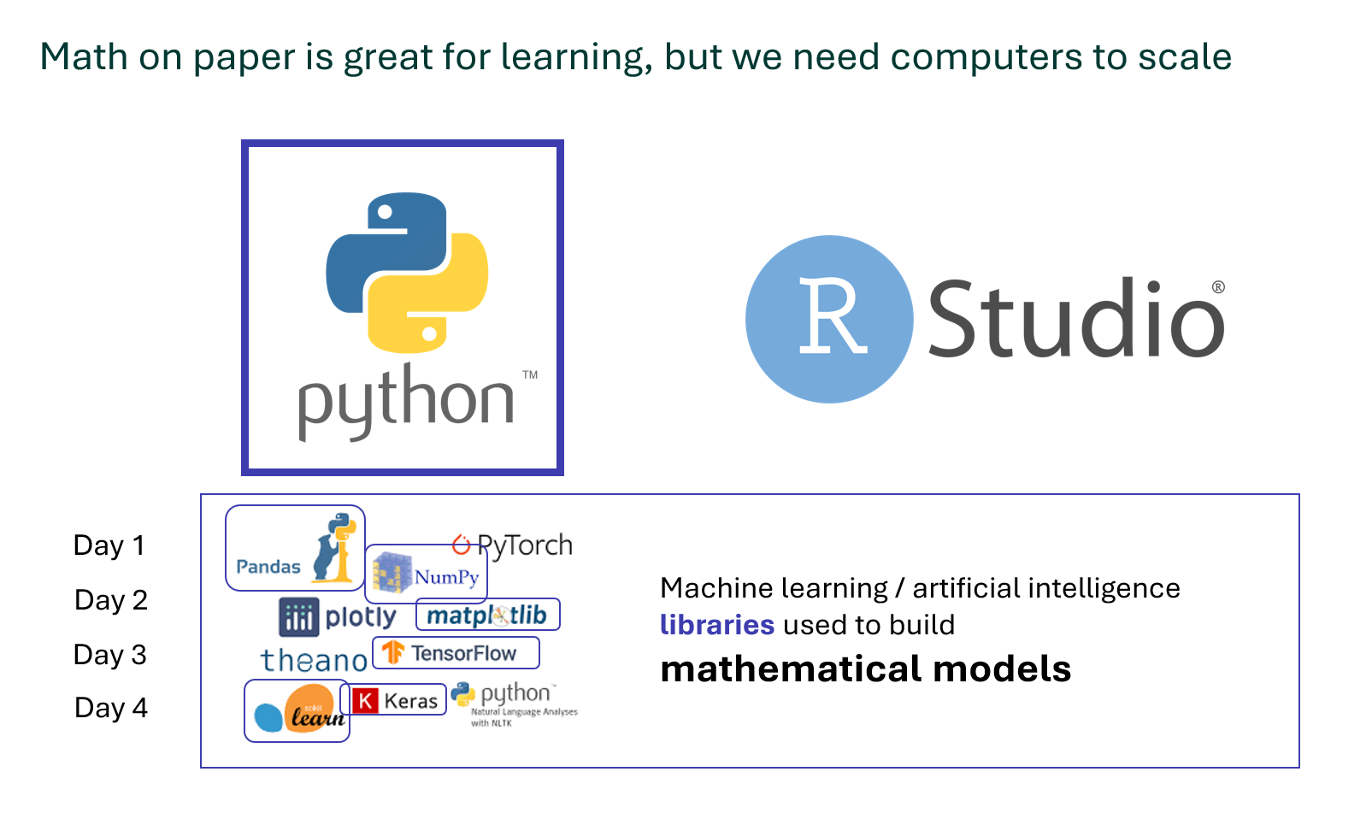
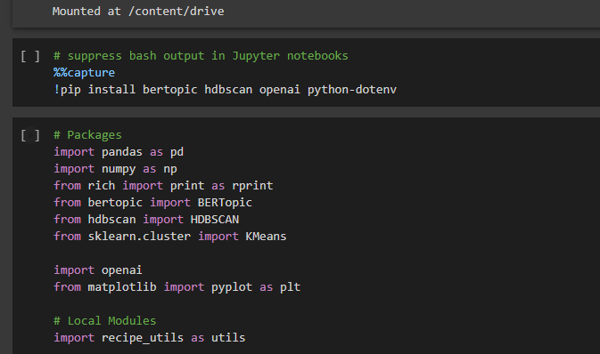
Day 1 Agenda
Presentation
Hands On Python Coding

Slide 6
Every technology and business around us uses math
Technology | How Math Is Used
Video Games | Graphics rendering
Netflix | Video compression
Spotify | Song recommendations
GPS | Location
Weather Forecasts | Sunny vs. cloudy
Market Research | What products will sell
Stock Market | What stocks will go up
ChatGPT | Writing like a human
Dall E | Creating artwork
Notes:
Math is used in all technology around us! Here are some examples.
ChatGPT was the example I just gave (except I made those models). As an example, my company pays $500 per month for ChatGPT. Their company is worth around $100 billion.

Slide 7


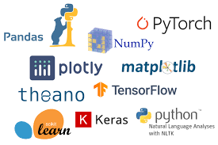
Math on paper is great for learning, but we need computers to scale
Day 1
Day 2
Machine learning / artificial intelligence libraries used to build mathematical models
Day 3
Day 4
Notes:
Math on paper or in your head helps with day to day stuff like calculating the tax at a store. But to do large scale math, we need computers. Python and R are the primary languages people like me use to build mathematical models.

Slide 8
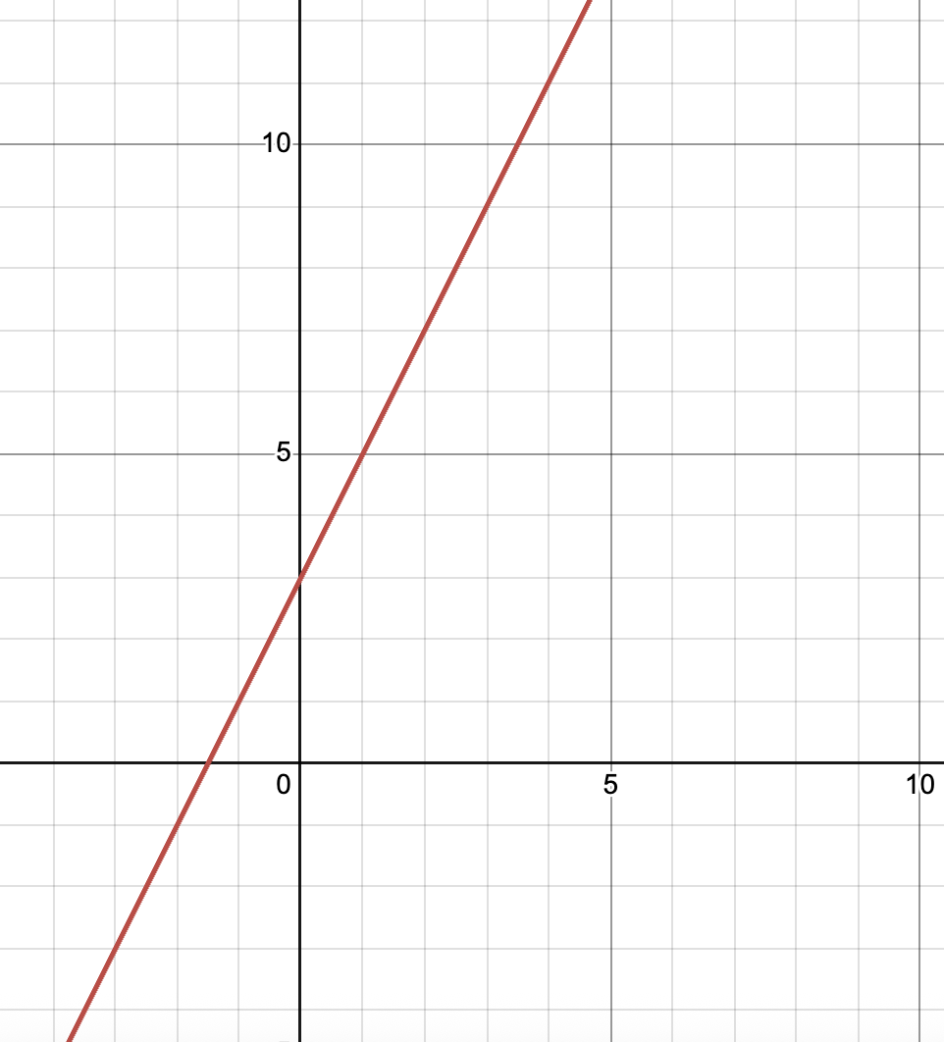
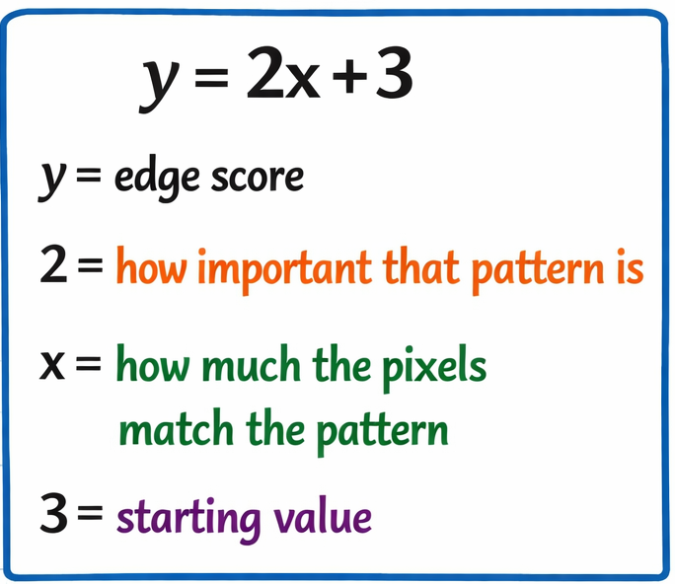
Here are the example calculations inside an AI model:
Image Recognition Example
>95%
of calculations in AI are
y = mx + b
Edge Score
Pixels

Slide 9
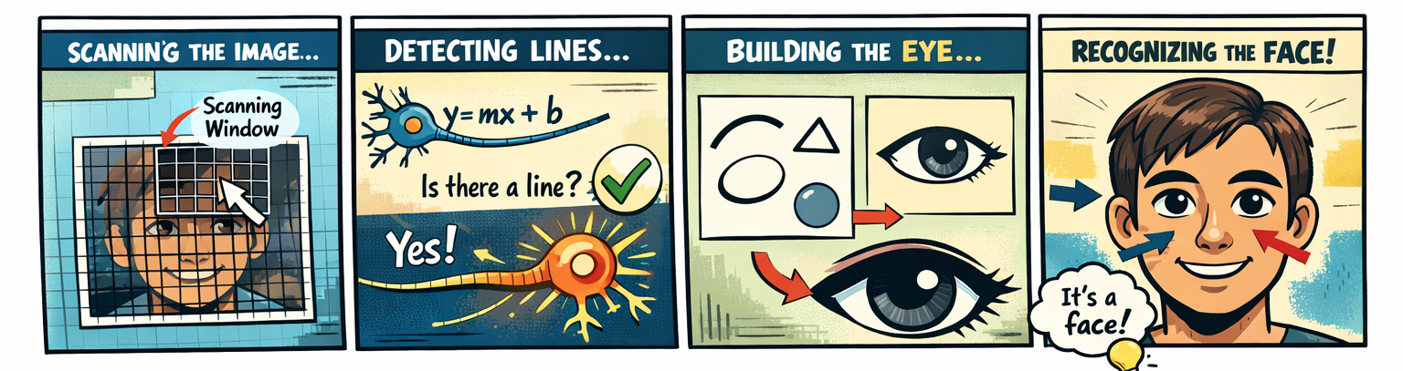
Images are processed by AI starting with the individual pixels, then lines, then shapes, then more and more complex patterns

Slide 10
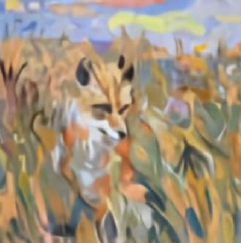
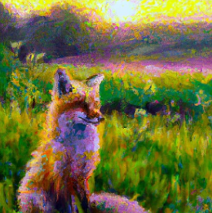
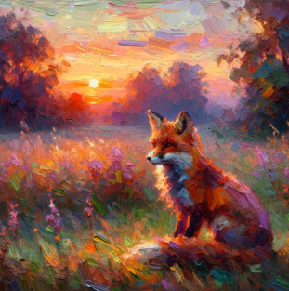
Why do we need to scale? Images
This is the same AI generated painting with three different model sizes.
Prompt: A painting of a fox sitting in a field at sunrise in the style of Claude Monet
Small
(100 million calculations)
Medium
(1 billion calculations)
Large
(10 billion calculations)
Notes:
Previously we talked about how Python allows us to do a lot of math

Slide 11
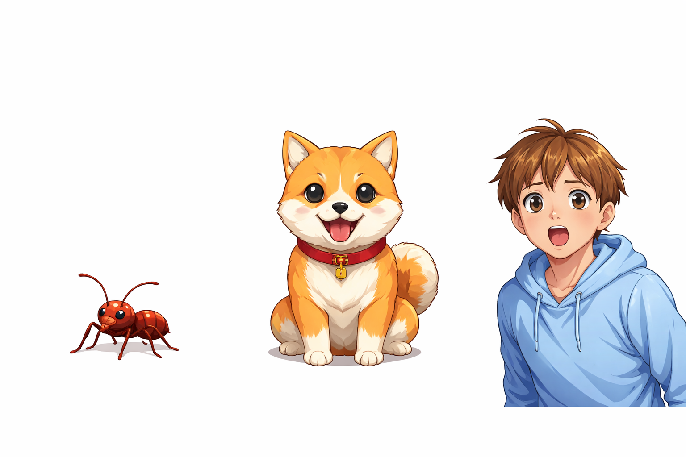
Our brains are like computers.
Small
(<1 million neurons)
Medium
(2 billion neurons)
Large
(86 billion neurons)

Slide 12


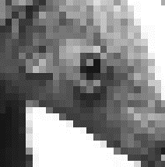
What is a model?
Inputs
Example: pixels
Output
Example: animal
Model
Model
Dog
Model
Cat
Pangolin
Model
Notes:
What’s a model? A model takes some inputs and gives an output. Think of an image as an example. The pixels of the image are the inputs. The output is the label of what the image is. Your brain works like a model. You can identify this image. What is this? Great job, it’s a dog. Now what is this? Yup, it’s a cat. You learned to identify dogs and cats at a very young age. Your brain does it automatically now, but it didn’t when you were first born. This last one is much harder because it’s an animal we don’t see very often. Can anyone guess it? It’s a pangolin. The point here is that some models are easy for humans are hard for computers. Some are hard for humans and easy for computers. What’s easy for us depends on what we see regularly.

Slide 13
Language Model
Can you guess the next word I’m going to _____?
Notes:
That was an example of an image model. Here’s an example with words. Can anyone guess the next word I’m going to…say?
In the last 10 years, computers have gotten good enough to be able to answer those correctly.
Over the next week, we’ll start with simpler models and build to more and more complex models like those AI models.

Slide 14
Let’s jump into Python!

Slide 15
Day 2: Simple Models

Slide 16
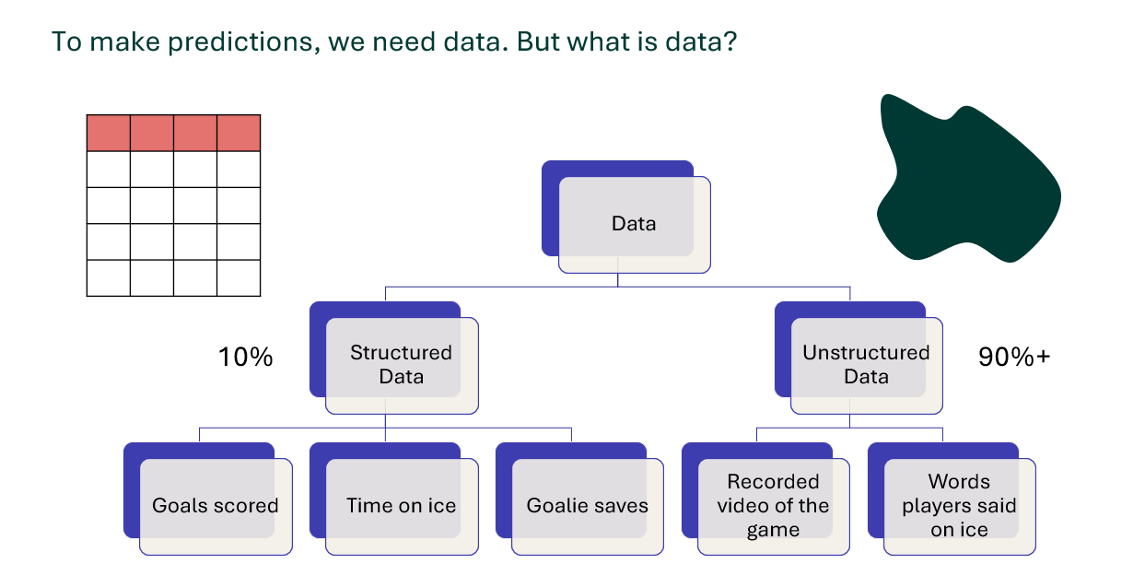
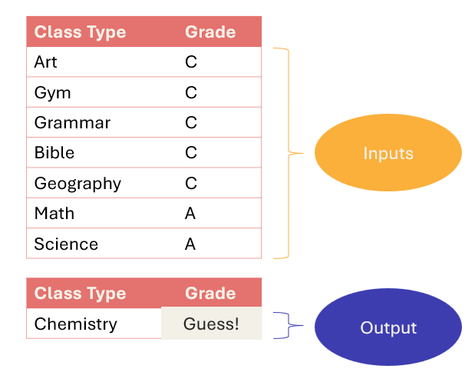
Day 2 Agenda
Presentation
Python Coding

Slide 17



What is a model? (Reminder from Day 1)
Inputs
Example: pixels
Output
Example: animal
Model
Model
Koala
Dolphin
Model
Koati
Model
Notes:
Just a reminder from yesterday. A model is something that can be used to take inputs and give an output as a prediction.

Slide 18
But what is a model?
1) Recognizes
Patterns
2) Makes
Predictions

Slide 19
Simplest model
Models find patterns
Inputs
Class # | Grade
1 | B
Output
Guess!
2 | B
Notes:
Models find mathematical patterns that use inputs to predict outputs.
Let’s look at a model that is easier to understand.
If someone got a B in 4 classes, what grade do you think they will get on their 5th class?
B is a safe guess.
You basically completed the pattern. In this case the pattern was obvious, but in math, we would describe that as a simple model that uses the average value to predict the future. It’s such as simple model you don’t even think of it as a model.

Slide 20
An example of a simple model
How can we predict a student’s future grade for class #4?
It’s not a hard pattern ☺
Class # | Grade
1 | A
2 | A
3 | A
Inputs
Output
Guess!
4 | A
Notes:
Models find mathematical patterns that use inputs to predict outputs.
Let’s look at a model that is easier to understand.
If someone got a B in 4 classes, what grade do you think they will get on their 5th class?
B is a safe guess.
You basically completed the pattern. In this case the pattern was obvious, but in math, we would describe that as a simple model that uses the average value to predict the future. It’s such as simple model you don’t even think of it as a model.

Slide 21
A bit more complicated example
How can we predict a student’s future grade for class #4?
This is a harder pattern
Class # | Grade
1 | B
2 | A
3 | C
Inputs
Output
Guess!
4 | B
Notes:
Models find mathematical patterns that use inputs to predict outputs.
Let’s look at a model that is easier to understand.
If someone got a B in 4 classes, what grade do you think they will get on their 5th class?
B is a safe guess.
You basically completed the pattern. In this case the pattern was obvious, but in math, we would describe that as a simple model that uses the average value to predict the future. It’s such as simple model you don’t even think of it as a model.

Slide 22
A slightly more complicated pattern – predict the grade!
Class Type | Grade
Art | C
Gym | C
Grammar | C
Spelling | C
Geography | C
Math | A
Science | A
Inputs
Class Type | Grade
Chemistry | A
Output
Guess!
Notes:
Now here is a more complicated example that will probably be hard but you might still be able to guess correctly. Think about it a bit before you answer… [Wait a minute for them.] As a hint, think about the types of classes. The answer is A, because this study is good at math and science and chemistry is closer to those than the other subjects.
Hopefully this example helps you see why it’s useful to understand how the pattern you used was an average.

Slide 23



Now let’s look at the formula for this model.
Inputs
Class # | Grade
1 | B
$$x$$
Output
$$y$$
2 | B
Model is the only grade we know
$y=$ $x$

Slide 24
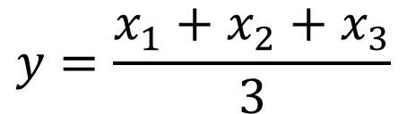



The model is the average!
Class # | Grade
1 | A
2 | A
3 | A
$$x_{1}$$
Inputs
$$x_{2}$$
$$x_{3}$$
Output
$$y$$
4 | A
The model is the average
$$y=\frac{x_{1}+x_{2}+x_{3}}{3}$$

Slide 25
The model is the average!
Class # | Grade
1 | B
2 | A
3 | C
$$x_{1}$$
Inputs
$$x_{2}$$
$$x_{3}$$
Output
$$y$$
4 | B
The model is the average
$$y=\frac{x_{1}+x_{2}+x_{3}}{3}$$

Slide 26

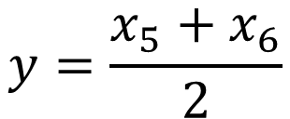






The math for the more complicated example!
Class Type | Grade
Art | C
Gym | C
Spelling | C
Geography | C
Math | A
Science | A
$$x_{1}$$
$$x_{2}$$
$$x_{3}$$
Inputs
$$x_{4}$$
$$x_{5}$$
The model is the average of similar classes
$$x_{6}$$
Class Type | Grade
Chemistry | A
Output
$$y$$
$$y=\frac{x_{5}+x_{6}}{2}$$

Slide 27

To make predictions, we need data. But what is data? A hockey example
Data
Words players said on ice
Recorded video of the game
Structured Data
Goals scored
Time on ice
Goalie saves
Unstructured Data
10%
90%+
Notes:
Structured data is easier to analyze, but there is much less of it.
Unstructured data is much harder to analyze. This is what big companies are starting to be able to analyze better and how they can build big models that can talk like they’re human.

Slide 28
Let’s jump into Python!

Slide 29
Day 3: Intro to Machine Learning Models

Slide 30
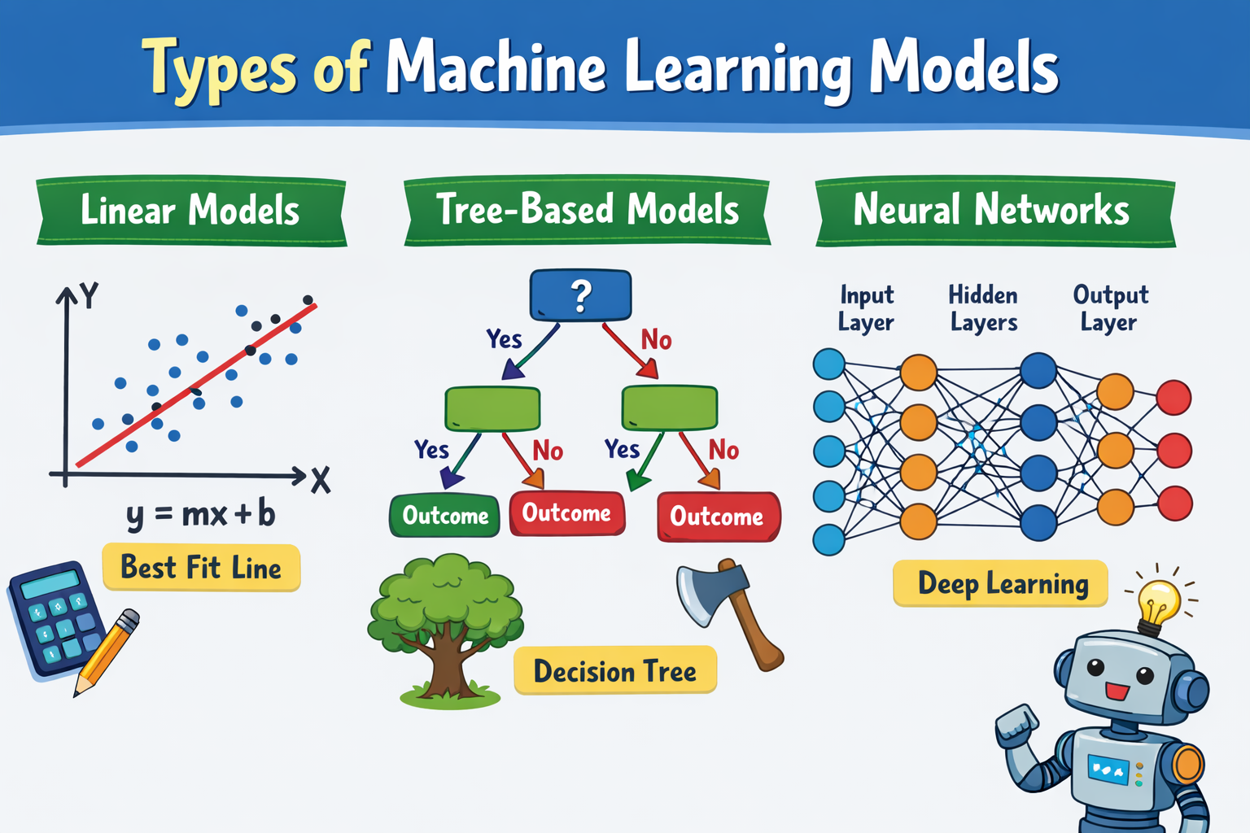
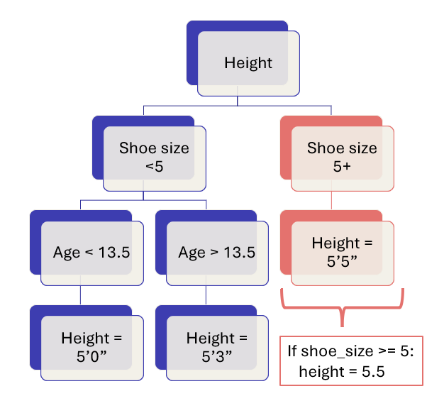
Day 3 Agenda
Presentation
Hands On Python Coding

Slide 31
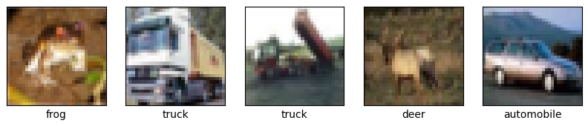
What is a model? (Reminder from Day 1)
Inputs
X
Output
y
Model
Model
Frog
Truck
Model
Deer
Model
Notes:
In machine learning, we call inputs X and we call outputs y.

Slide 32
But what is a model?
1) Recognizes
Patterns
2) Makes
Predictions

Slide 33
Common Misconception: Is AI always learning, just like us?
What people assume
AI is constantly absorbing new info from every conversation — like a student who never stops studying.
What's actually true
AI has two completely separate phases — and they never happen at the same time.

Slide 34
How Machine Learning Actually Works: Two separate modes. Never both at once.
Study mode
AI reads billions of examples and slowly adjusts. This takes weeks or months on powerful computers
Answer mode
AI answers questions — but the books are taken away. It can only use what it already learned.

Slide 35
Notes:
There are many types of machine learning models. We learned linear models yesterday and I’ll teach you tree-based models today. Day 4 will be neural networks.

Slide 36
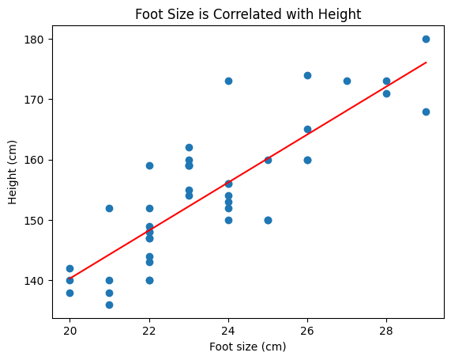
Linear Models – Reminder from Day 2
Notes:
Linear means the model uses a line.
Many patterns are like a line. A line basically means, as you increase something, the other thing increases at the same rate.

Slide 37
What if your pattern doesn’t look like a straight line?
Notes:
Here’s an example of a non-linear relationship. Soup tastes better with a bit of salt. But if you add too much, it starts to taste worse and worse.

Slide 38
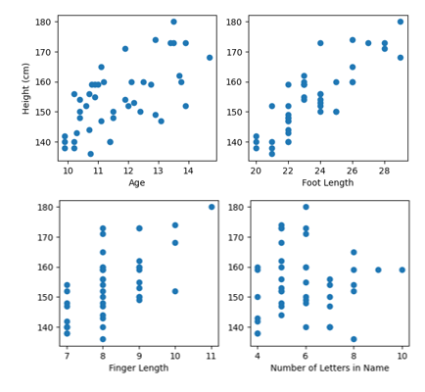
We can improve our models with multiple variables
One Variable
Multiple Variables

Slide 39
Decision Tree Model
Height
Age > 10.25
Age <= 10.25
Foot Length <= 22.5
Foot Length > 22.5
Height = 158cm
Height = 139cm
Height = 146cm
Age <= 12.8
Age > 12.8
Height = 170cm
Notes:
This is an example of a tree-based model. It’s called tree based because it “grows” out like a tree from the base (like an upside down tree).

Slide 40
Decision Tree Model
Height
Age > 10.25
Age <= 10.25
Foot Length <= 22.5
Foot Length > 22.5
Height = 158cm
Height = 139cm
Height = 146cm
Age <= 12.8
Age > 12.8
Height = 170cm
What’s the big limitation here?
if foot_length <= 22.5:
if age <= 10.25
height = 139
Notes:
If we go down each branch separately, we can see how predictions are made. In this case, we see that if a student has a foot smaller than 22.5 cm and is under 10 years and 3 months old, then it predicts they will be 139cm tall.
The big limitation is that it only makes 4 predictions.
Note that we can make a larger tree, but then it will overfit.

Slide 41
What is this called? A Model with Many Trees Combined!
Random Forest Model
Height
Age > 13.5
Age < 13.5
Shoe size <5
Shoe size 5+
Height = 5’5”
Height = 5’0”
Height = 5’3”
Height
Age > 13.5
Shoe size <5
Shoe size 5+
Height = 5’5”
Height = 5’0”
Height = 5’3”
Height
Age < 13.5
Shoe size <5
Shoe size 5+
Height = 5’5”
Height = 5’0”
Height = 5’3”
Height
Shoe size <5
Shoe size 5+
Height = 5’4”
Height = 5’0”
Gender = Girl
Gender = Boy
Height = 5’6”
+
+
+
…
+
Notes:
A decision tree is not a good predictive model by itself. But a decision tree combines a bunch of separate decision trees and uses the average prediction to be very accurate. It’s called a forest because it is made up of a bunch of trees.

Slide 42
Let’s jump into Python!

Slide 43
Day 4: Intro to Neural Networks

Slide 44
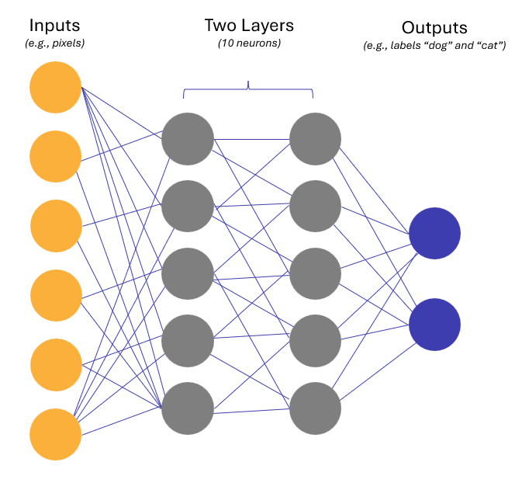
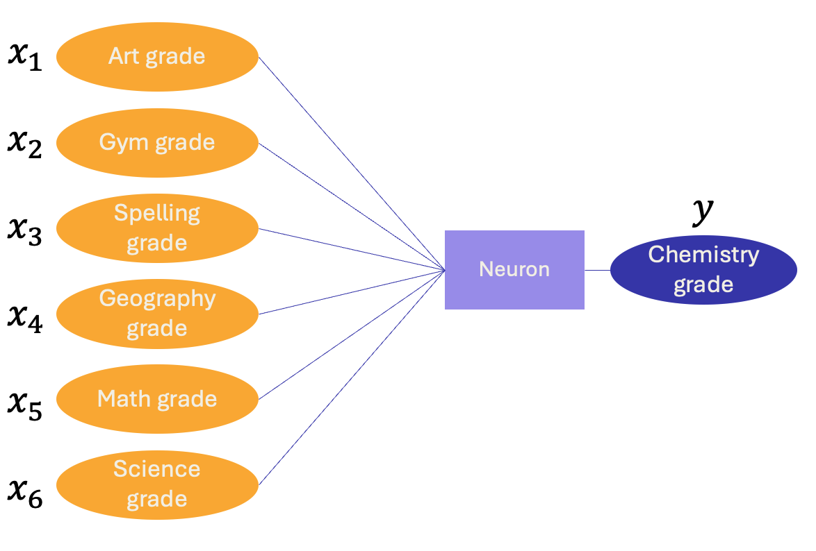
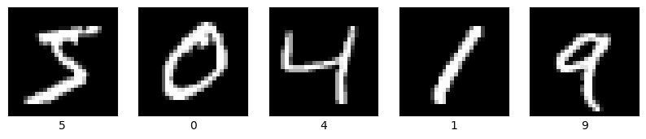
Day 4 Agenda
Presentation
Hands On Python Coding

Slide 45
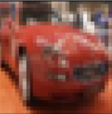
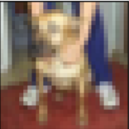

What is a model? (Reminder from Day 1)
Inputs
X
Output
y
Model
Model
Car
Dog
Model
Bird
Model
Notes:
In machine learning, we call inputs X and we call outputs y.

Slide 46
What does a model do?
1) Recognizes
Patterns
2) Makes
Predictions

Slide 47
Notes:
There are many types of machine learning models. Yesterday we learned about tree-based models. Today we’ll learn about neural networks which are used to build AI.

Slide 48
When are neural networks better than other types of models?
1) Very complex patterns
2) Lots of data

Slide 49
Brief History of Neural Networks
Time | Developments / Inventions
1950s | Computers invented. Neural networks invented.
1980s-90s | AI learning algorithms invented.
2012 | Deep learning demonstrated major improvements
2015 | OpenAI founded (makers of ChatGPT became a company)
2017 | Transformers invented (method behind all latest AI breakthroughs)
2020 | GPT-3 invented (AI that can read and write like a human)
2022 | ChatGPT released (Free to use AI chat interface, fastest growing product ever)
2023 | GPT-4 released (much improved AI)

Slide 50
The simplest neural network is just another way to write the formula of a line!
Slopes are called Weights
x
y
m
Shoe size
Neuron
Height
m*x + b
Same as the formula for a line, just re-arranged.

Slide 51










Re-writing our weighted average to neural network format
$$x_{1}$$
$$x_{2}$$
$$x_{3}$$
$$x_{4}$$
$$x_{5}$$
$$x_{6}$$
Art grade
Class Type | Grade
Art | A
Gym | A
Spelling | A
Geography | A
Math | B
Science | B
$$x_{1}$$
$$x_{2}$$
Weights
0
0
0
0
3
3
Gym grade
$$x_{3}$$
$$m_{1}$$
$$m_{2}$$
$$m_{3}$$
$$m_{4}$$
$$m_{5}$$
$$m_{6}$$
$$x_{4}$$
$$y$$
Spelling grade
$$x_{5}$$
Neuron
Chemistry grade
$$x_{6}$$
Geography grade
Class Type | Grade
Chemistry | B
Math grade
$$y$$
Science grade
Notes:
Remember that example from day 2? I changed the grades. What would you predict this time?

Slide 52
A “Deep” Neural Network with 2 layers and 10 neurons
Inputs
(e.g., pixels)
Two Layers
(10 neurons)
Outputs
(e.g., label of animal)
Each of these grey circles is a neuron

Slide 53
Ignoring Relative Location
A normal model sees each pixel as a separate input.
They’re both just lines!
Notes:
We interpret both of these images as the same thing. It’s just a line. It doesn’t matter which pixel it starts.
But a normal model sees these as completely different.

Slide 54

Convolutions
Each pattern is a neuron. They’re sometimes called filters.
Aha! I detected part of a line!
Aha! I detected a line down the middle!

Slide 55
Example: Predicting Images x2

Slide 56
Neural networks are best with complex data

Slide 57
Neural networks are best with complex data

Slide 58
Let’s jump into Python!

